Slide 1
Hot Weather Kills
Mike Bryant
Wills Harris
Steve Woo
Isaac Soto

Slide 2

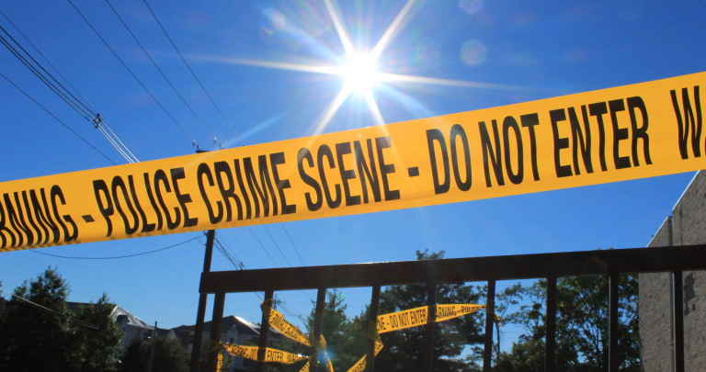
Summary
Core purpose
Find the extent to which increased temperature has an impact on crime rates in Los Angeles.
Previous Research
Research findings:
Increased crime rate: 5.7% for violent crime
Areas built prior to 1949
Decreased efforts of law enforcement
Notes:
-We can all relate to the fact that we might get a little cranky on hot days? Question is how cranky does one get?
-Previous studies have shown that an increase in temperature do lead to an uptick in crime
-Our motivation behind our study is to examine 1) the correlation close to home and 2)

Slide 3

Where to gather data from
Questions
Source of Data?
Crime data gathered from LA city website
Weather data gathered from Open Weather document
Area to examine?
Time range of data?
Notes:
-Sources of Data
-crime data ranging fro

Slide 4
Weather Data
Resample dataset to obtain daily average temperature from hourly recordings

Slide 5
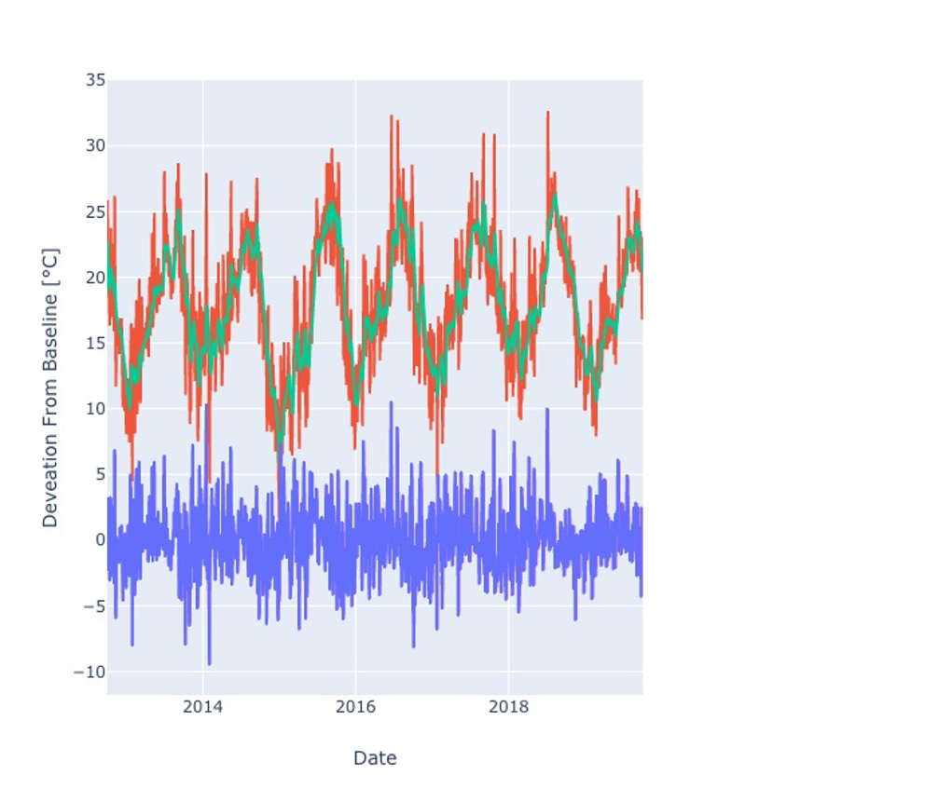
Weather Data
Resample dataset to obtain daily average temperature from hourly recordings
Remove seasonal variation by subtracting moving average

Slide 6
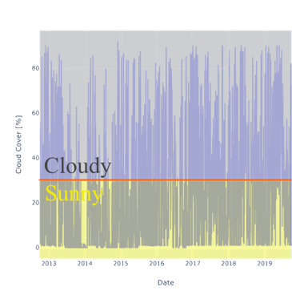
Weather Data
Resample dataset to obtain daily average temperature from hourly recordings
Remove seasonal variation by subtracting moving average
Report average cloud cover and drop days above a threshold coverage

Slide 7
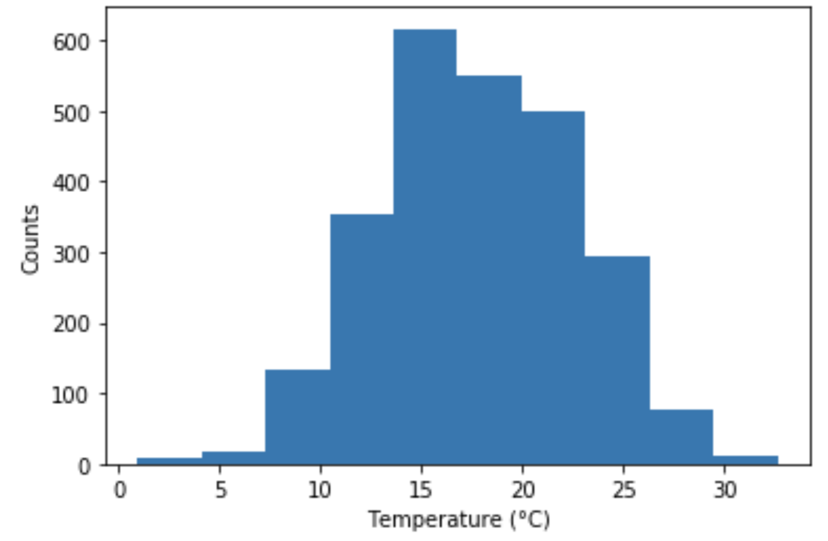
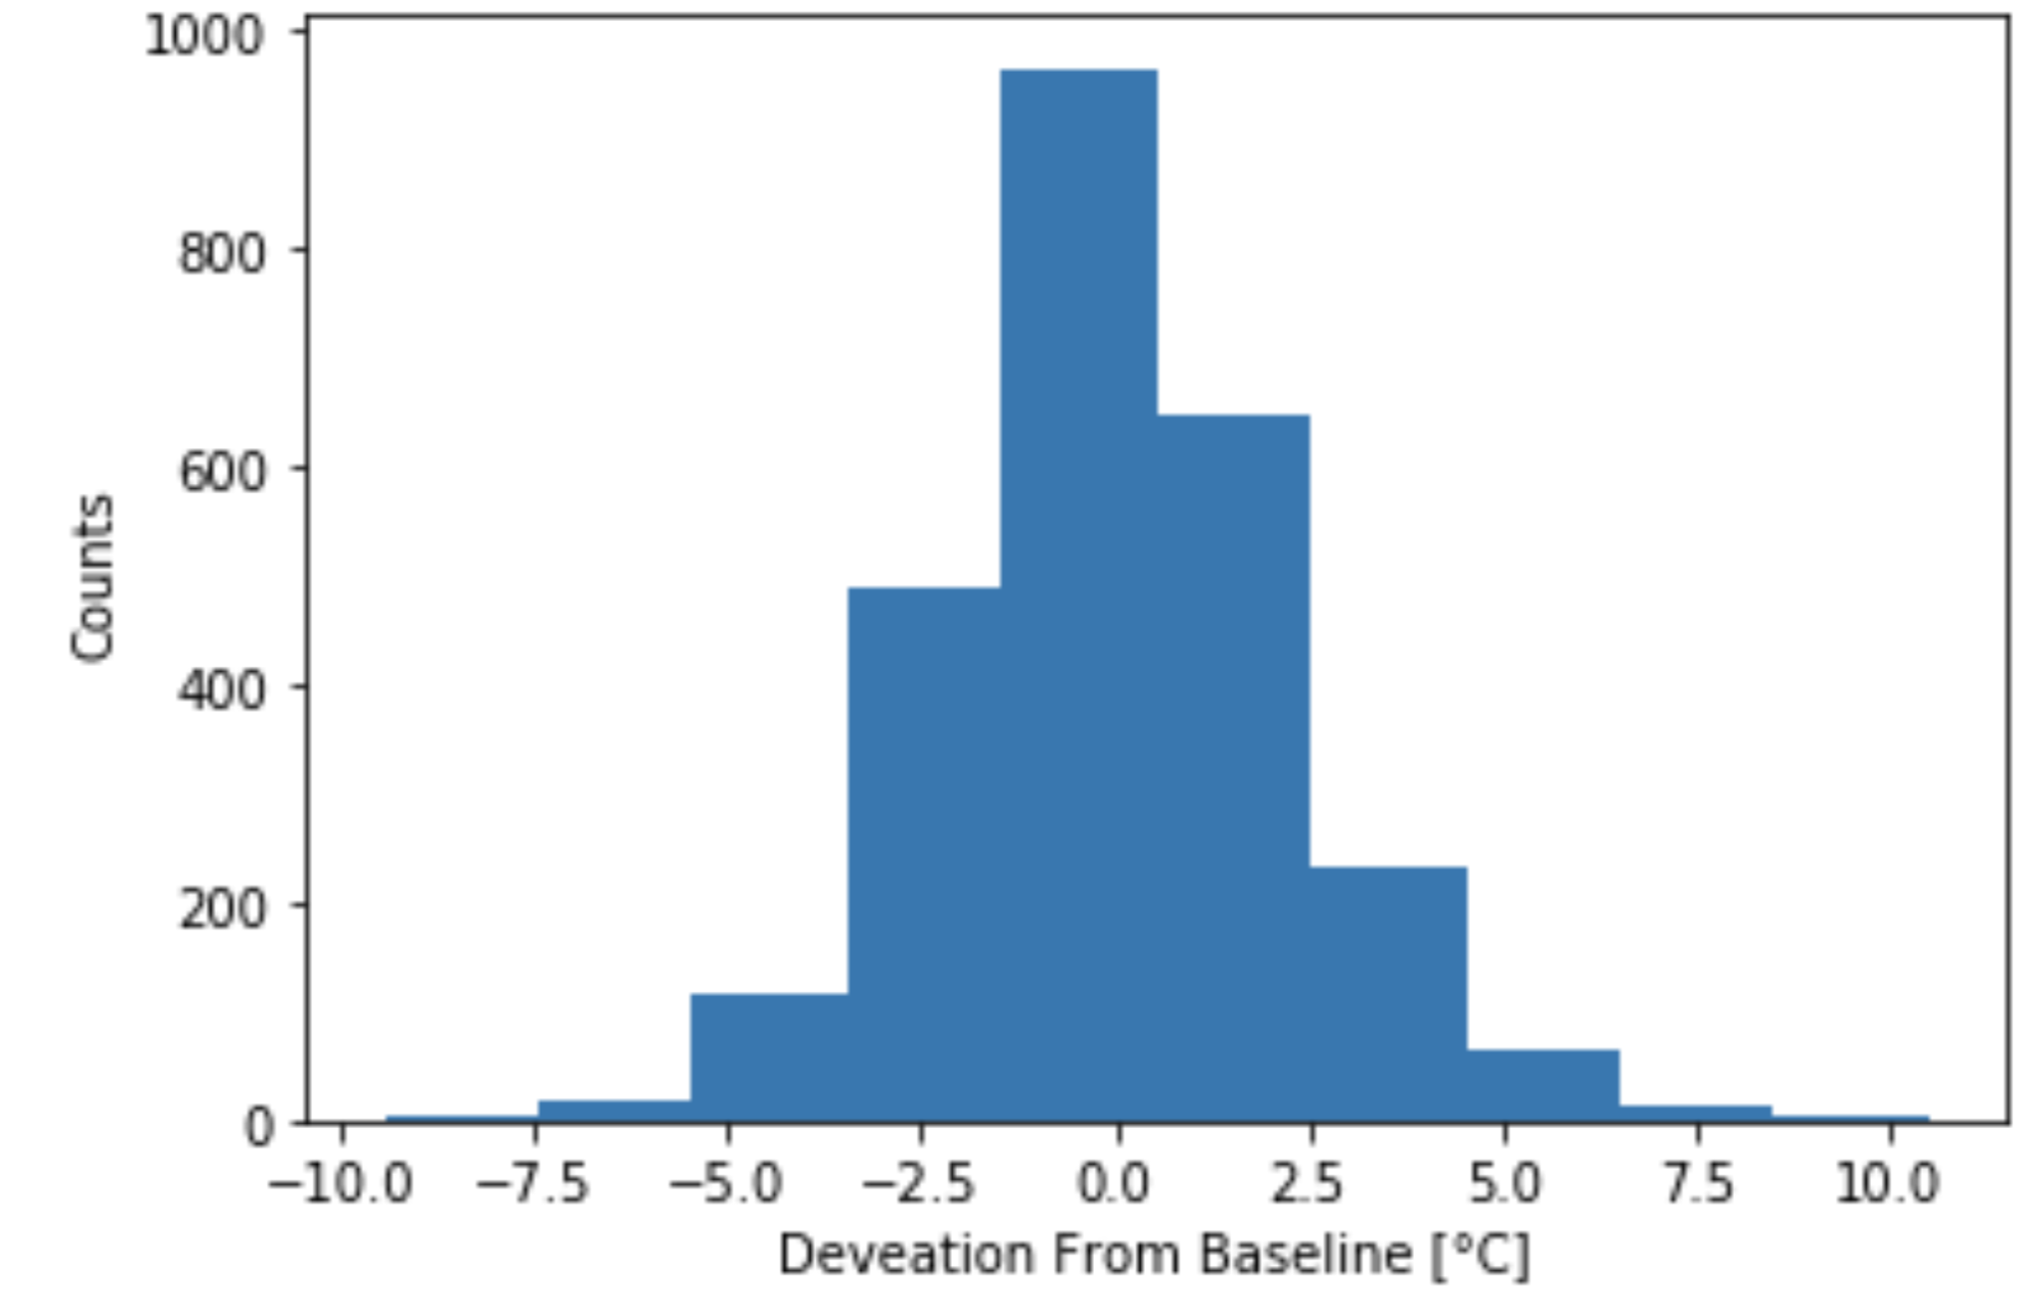
Weather Data
Resample dataset to obtain daily average temperature from hourly recordings
Remove seasonal variation by subtracting moving average
Report average cloud cover and drop days above a threshold coverage
Check if temperature data is normally distributed

Slide 8
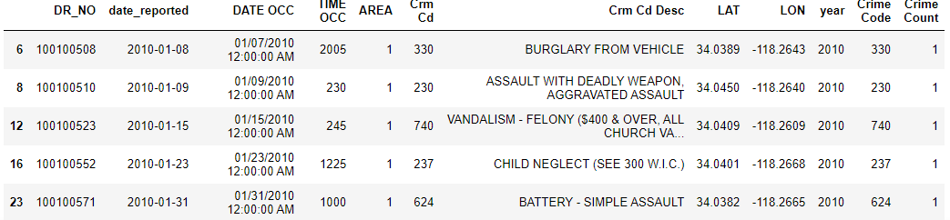
Crime Data Analysis
Import crime data csv, tested using sample for 100,000 samples; applied to original data;
sample_data = clean_data.sample(n=100000)
Clean up unsuable data by eliminating columns
org_crime_data = crime_data.drop(columns=['Crm Cd 1', 'Crm Cd 2', 'Crm Cd 3', 'Crm Cd 4', 'Rpt Dist No',
'Part 1-2', 'Status', 'Status Desc', 'LOCATION', 'Cross Street', 'Vict Age',
'Vict Sex', 'Vict Descent', 'Premis Cd', 'Premis Desc', 'Weapon Used Cd',
'Weapon Desc', 'AREA NAME', 'Mocodes'])
clean_data = org_crime_data.rename(columns={'Date Rptd':'date_reported'})
=> Included underline instead of space, to make it easier to apply to the codes
Convert date data into weather data-favorable format
-> enables comparison much easier
year = pd.DatetimeIndex(clean_data['date_reported']).year

Slide 9
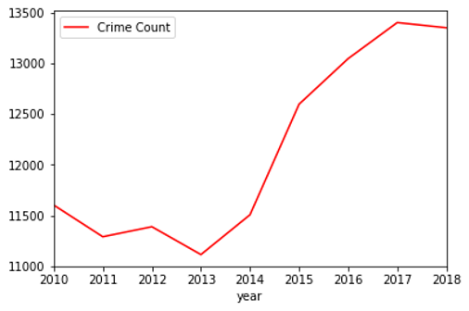
Crime Data Analysis
Limit the latitude and longitude of data to zip code 90057
lon_sample = clean_data[clean_data['LON'].between(-118.2800, -118.2600)]
mid_LA_sample = lon_sample[lon_sample['LAT'].between(34.0000, 34.2000)]
Group the Dataframe by Penal Codes, for # of crimes
count_crime = mid_LA_sample.groupby(['Crime Code', 'year', 'date_reported']).sum()
count_crime = count_crime.sort_values(by='date_reported')
Add column for counting # of Penal Codes (count = 1 for all data)
-> Add by .sum(), determine how many crimes had occurred
crime_count = 1
mid_LA_sample['Crime Count'] = crime_count
mid_LA_sample.head()
Split string values of crime description, for uniform description
Graph indicates high spike of # of crimes since year 2014 (Brief Idea of Data)
Notes:
#Discuss the steps you took to analyze the data and answer each question you asked in your proposal #Present and discuss interesting figures developed during analysis, ideally with the help of Jupyter Notebook

Slide 10
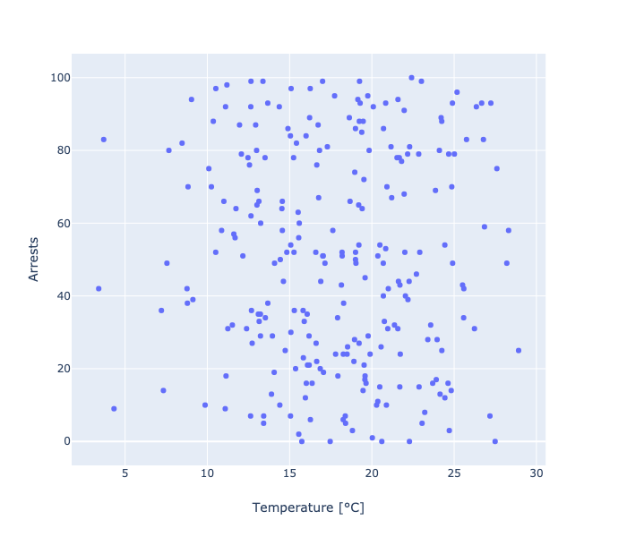
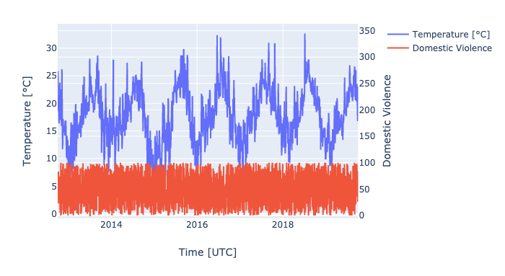
Domestic Violence

Slide 11
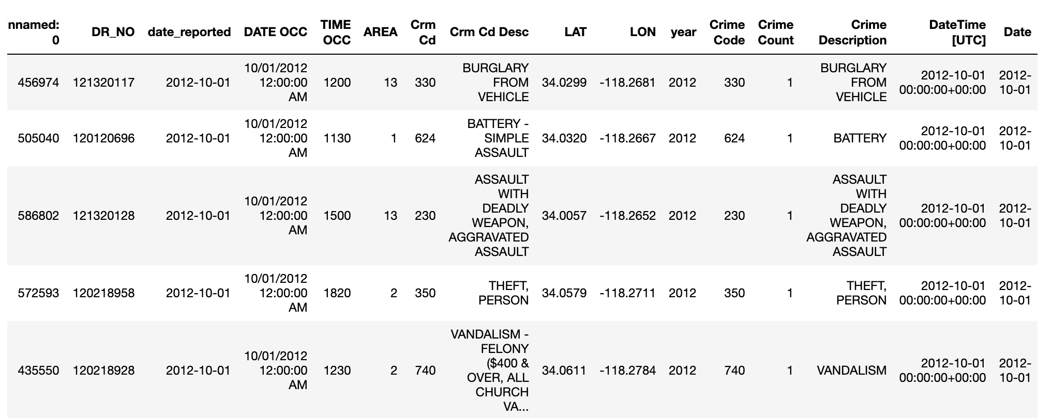
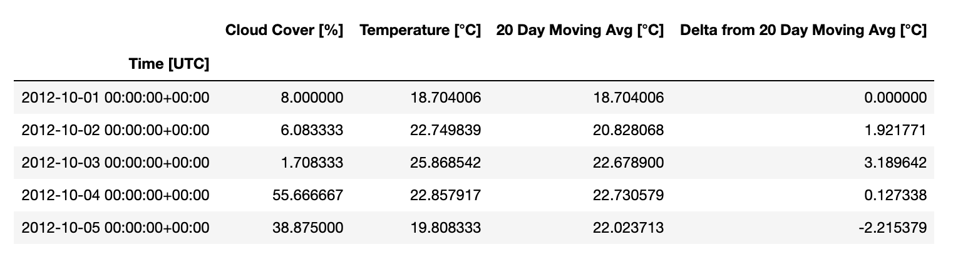
Post Mortem
Cleaning time series data is tricky
Python is not Matlab, break your matlab habits if you can
Data cleaning will take longer than you think
Notes:
#Discuss any difficulties that arose, and how you dealt with them #Discuss any additional questions that came up, but which you didn't have time to answer: What would you research next, if you had two more weeks?

Slide 12
Questions
Notes:
#Open-floor Q&A with the audience

